Slide 1

Product Agile WORKSHOP
OCEP AGILE REFRESHER

Slide 2
WORKSHOP GOALS
During this workshop we will review…
Refresher: The Difference between Product and Project
Refresher: Maintaining a Product Value Stream
Refresher: The Product Development Process
Refresher: Product Backlog Item Maturity
Refresher: Product Ownership Metrics

Slide 3
WORKSHOP PRODUCT VS PROJECT
(1 of 3)
ATTRIBUTE | PROJECT | PRODUCT
Initiative Kick-off | Project Manager (PrjM) brings together client, stakeholders, team to review high-level Project Management Initiative | N/A (Initiatives are just content in the backlog that requires prioritization and refinement)
Initiative Content | PrjM leads creation of Work Breakdown Structure, milestones, and resource allocations | Product Owner (PO) works with client to create Features under Capability in Product Backlog.
Initiative Content Analysis | PrjM works with specialized roles (architects, analysts, etc) to examine WBS goals and further decompose and estimate | PO leads team in Product Refinement sessions and specialized roles may attend to guide and support the team

Slide 4
WORKSHOP PRODUCT VS PROJECT
(2 of 3)
ATTRIBUTE | PROJECT | PRODUCT
Initiative Prioritization | PrjM responsible for technical activity-focused dependency-oriented finish to start timeline with a focus on estimations, critical path, and resource availability | PO establishes User-focused value-driven increments prioritized often based on “weighted shorted-job first” with an eye on dependency reduction outside the team
Initiative Progress Management | PrjM leads resource re-allocation while maximizing parallel activity to reduce risk around the critical path | Product Owner (PO) observes team-level velocity to approximate product backlog item (PBI) completion, sprint-by-sprint, while serving team in Team-level retrospectives to support continuous process improvement

Slide 5
WORKSHOP PRODUCT VS PROJECT
(3 of 3)
ATTRIBUTE | PROJECT | PRODUCT
Initiative Risk Management | PrjM focused on negotiating changing expectations with client by communicating root-cause factors and maintaining a risk registry (risk breakdown structure) to coordinate resolution, mitigation, and ownership) | PO supports team by helping coordinate risks identified by the team coming from Product Refinement, Sprint Planning, and is a resource to the team during Daily Scrum meetings.
Initiative Timeline Management | PrjM owns master project plan, watches critical path items that connect initiative technical SDLC-style milestones focusing on predetermined deadline (Estimation by date) | PO focus on Prod Backlog priority, maturing the state of features by refinement and sprinting, updating roadmaps relative to team velocity. (Empiricism by Quarter)

Slide 6
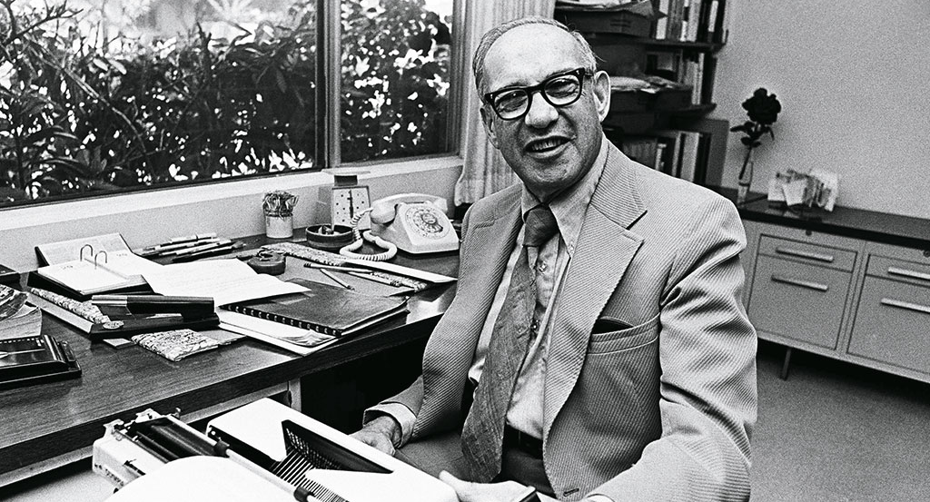
WORKSHOP PRODUCT VALUE STREAM
“
Quality in a product or service is not what the supplier puts in. It is what the customer gets out and is willing to pay for. A product is not quality because it is hard to make and costs a lot of money…
- PETER DRUCKER

Slide 7




WORKSHOP PRODUCT VALUE STREAM
Understanding your product starts with identifying what the customer is paying for despite the cost or labor associated with individual components of the product.
You find the components by tracing the path of necessary activity associated with producing the value proposition.
Activity 3
Activity 2
Activity 1
?
Activity 4
Activity 5
Activity 6
!
Agile Dev Team
Client

Slide 8


WORKSHOP PRODUCT VALUE STREAM
For each activity, determine if it is V (value-add) or NV (non-value add):
Can this activity be done by the Agile Team? (PO, Agile Dev Team Members, SM)
Does this contribute directly to the value of the outcome?
Is this activity a “Gate”?
Activity 3
Activity 2
Activity 1
?
Activity 4
Activity 5
Activity 6
!
Agile Dev Team
Client

Slide 9
WORKSHOP PRODUCT VALUE STREAM
Between each activity, is there W (wait time) or NW (Non-wait time)?
Is the movement between activities…
on-demand (as opposed to scheduled periodically)?
push (as opposed to pull)?
Is the next actor in the activity chain a fixed person (as opposed to a role where multiple people could do the activity)?
Activity 3
Activity 2
Activity 1
?
Activity 4
Activity 5
Activity 6
!
Agile Dev Team
Client

Slide 10
WORKSHOP PRODUCT VALUE STREAM
How long does it take to get a PBI from ideation to refinement with the team?
Activities and Wait are measured in approximate d(ays) and h(hours)
Add up the time from Left to Right in the top Row Analyze this from time to time and make this a topic at Team-level retrospectives! If you are dependent on other teams or people, discuss at Product-level retrospectives!
Activity 3
NV: 10d
Activity 2 V: 5d
Activity 1
NV: 5d
?
W: 2d
NW: 0d
W: 2d
Activity 4
Activity 5
Activity 6
!
Agile Dev Team
Client

Slide 11
WORKSHOP PRODUCT VALUE STREAM
How long does it take to get a PBI from refinement to production?
Do you refine each story with the team before you add it to a sprint?
Are you dependent on other teams or people off the team during a sprint?
Does the sprinting workflow have “gated” activities that are not automated? Analyze this topic at Team-level retrospectives and Product-level retrospectives!
Activity 3
NV: 10d
Activity 2 V: 5d
Activity 1
NV: 5d
?
W: 2d
NW: 0d
W: 2d
Activity 4
V: 10d
Activity 5
V: 10d
Activity 6
NV: 2d
!
Agile Dev Team
W: 2d
NW: 0d
W: 2d
Client
Notes:
Breakout: Identify the Product Value Stream

Slide 12

WORKSHOP PRODUCT DEVELOPMENT PROCESS: ACTORS
Who participates? PRODUCT MANAGER
Role:
Core Responsibilities:
DOs:
DON’Ts:
Own Product Vision, and the roadmap (capabilities-level).
Ensure “Solution Trains” deliver the right value.
Ensure initiative dependencies are coordinated, Participate in reducing team dependencies, ensure initiative execution matches team(s) velocities
Try to build a deadline-oriented roadmap, use a Gantt chart
PM
RTE
PO
Agile Dev Team
SM
Client
Specialist
Notes:
Does this match your experience today?
What is being done by this role today but is not on this list?
Why should this role be responsible for these things?
Why should this role avoid the DON’Ts?

Slide 13
WORKSHOP PRODUCT DEVELOPMENT PROCESS: ACTORS
Who participates? RELEASE TRAIN ENGINEER
Role:
Core Responsibilities:
DOs:
DON’Ts:
Ensure scaled-level events and artifacts are successful
Coach POs and SMs on working with other Teams
Help POs pre-plan for next PI, Help SMs establish cross-team collaboration during a PI, coordinate PI Planning event, ensure information radiators are available to all
Plan the PI, Manage cross-team dependencies for teams, become responsible for PI delivery or status reporting
PM
RTE
PO
Agile Dev Team
SM
Client
Specialist
Notes:
Does this match your experience today?
What is being done by this role today but is not on this list?
Why should this role be responsible for these things?
Why should this role avoid the DON’Ts?

Slide 14
WORKSHOP PRODUCT DEVELOPMENT PROCESS: ACTORS
Who participates? PRODUCT OWNER
Role:
Core Responsibilities:
DOs:
DON’Ts:
Ensure Initiative Vision is turned into backlog value
Prioritize backlog and promote shared PBI clarity
Orchestrate the creation of the backlog, facilitate clarification of PBIs, coordinate backlog content communication for all, set Sprint agenda
Manage a project plan, tell Dev Teams which stories to work on, ask for arbitrary status updates from the team
PM
RTE
PO
Agile Dev Team
SM
Client
Specialist
Notes:
Does this match your experience today?
What is being done by this role today but is not on this list?
Why should this role be responsible for these things?
Why should this role avoid the DON’Ts?

Slide 15
WORKSHOP PRODUCT DEVELOPMENT PROCESS: ACTORS
Who participates? AGILE DEV TEAM
Role:
Core Responsibilities:
DOs:
DON’Ts:
Analyze, Plan, and Execute PBI vision to production
Analysis, Design, Development, Testing, Go-Live, Support
Participate in backlog refinement, determine testable PBI acceptance criteria, estimate PBIs, select PBIs for sprints that match PO Sprint Agenda, author the Sprint Plan, inspect and adapt plan daily, review sprint outcomes
Let others do any of the above for them
PM
RTE
PO
Agile Dev Team
SM
Client
Specialist
Notes:
Does this match your experience today?
What is being done by this role today but is not on this list?
Why should this role be responsible for these things?
Why should this role avoid the DON’Ts?

Slide 16
WORKSHOP PRODUCT DEVELOPMENT PROCESS: ACTORS
Who participates? SCRUM MASTER
Role:
Core Responsibilities:
DOs:
DON’Ts:
Continuously improve Agile factors across all actors
Ensure everyone “masters scrum”
Ensure all scrum events occur and coach according to definition, be a sounding-board on method selection and implementation with the framework, mature org agility
Become a secretary, take responsibility (only model for a short period) for anything in the framework
PM
RTE
PO
Agile Dev Team
SM
Client
Specialist
Notes:
Does this match your experience today?
What is being done by this role today but is not on this list?
Why should this role be responsible for these things?
Why should this role avoid the DON’Ts?

Slide 17
WORKSHOP PRODUCT DEVELOPMENT PROCESS: ACTORS
Who participates? CLIENT
Role:
Core Responsibilities:
DOs:
DON’Ts:
Communicate needs in terms of roles and outcomes
Own the domain-space usage of product solutions
Participate in sharing insights during product management creation of the backlog, answer questions during refinement, participate in realized work during Sprints, provide insights during Sprint Reviews on “what’s next”
Answer ideation questions and disappear until the work is done
PM
RTE
PO
Agile Dev Team
SM
Client
Specialist
Notes:
Does this match your experience today?
What is being done by this role today but is not on this list?
Why should this role be responsible for these things?
Why should this role avoid the DON’Ts?

Slide 18
WORKSHOP PRODUCT DEVELOPMENT PROCESS: ACTORS
Who participates? SPECIALISTS
Role:
Core Responsibilities:
DOs:
DON’Ts:
Contribute to the quality of outcomes
Being a resource for the Agile Team throughout
Be available in their specialty to offer insights and answers, offer contextual best practices and guidance, attend process events when invited, expose key factors relative to questions, own specialty practice
Make decisions for teams, make decisions for products, do work the team or client should be doing
PM
RTE
PO
Agile Dev Team
SM
Client
Specialist
Notes:
Does this match your experience today?
What is being done by this role today but is not on this list?
Why should this role be responsible for these things?
Why should this role avoid the DON’Ts?

Slide 19
WORKSHOP PRODUCT DEVELOPMENT PROCESS: Part 1
From IDEATION to READY-FOR-REFINEMENT
1. New Product Value Proposed
2. Product Capability & Features Created
3. Product Capability Solution Train investigation
4. Initial Feature Allocations
5. Feature Story Mapping
PM
RTE
PO
Agile Dev Team
SM
Client
Specialist
1
2
3
4
5
3
4
4
5
5
1
2
5
3
Notes:
Each step here has a number, and below each role You can see their associated involvement in that step.
If the number is in a grey circle, that means they are not required to participate regularly in that step.
If a number is missing and not associated with a role, it means they should not participate at all in that step.
Who are the top 3 busiest roles in Part 1 of the Product Development Process
The Product Manager
The Client
The PO
What is the <insert role from above here> doing in these activities?
Why should <insert role from above here> do that at this step?
Why should <insert role from above here> avoid doing <some out of order activity> at that time?
Why isn’t <insert role from above here> involved in this step?

Slide 20
WORKSHOP PRODUCT DEVELOPMENT PROCESS: Part 2
From REFINEMENT to PRODUCTION
5
6. Solution Train Updates
7. Pre-PI Planning
X. Scrum of Scrums
9. Post-PI Inspect & Adapt
10. Solution Train End
Y. PO Sync
8. Sprint (1 or more)
8.a Team Product Refinement
8.b Feature PBI Prioritization
8.1 Team Sprint Planning
8.2 Daily Scrum
8.3 Sprint Review
8.4. Sprint Retrospective
PM
RTE
PO
Agile Dev Team
SM
Client
Specialist
6
7
9
10
6
7
9
10
6
7
9
10
8.a
8.a
8.1
8.2
8.3
8.4
X
8.a
8.1
8.2
8.3
8.4
6
8
8.3
10
8
9
X
Y
8.b
8.1
8.2
8.3
8.4
8.b
X
Y
Y
Notes:
Let’s check out the busiest people in Part 2:
The Product Owner
Then the Agile Dev Team
Then the Scrum Master
During Part 2 the Product Manager lives at the Solution Train Level completely above the Red Line
Who else lives above the Red Line? (answer: the RTE) What are they doing? (answer: ensuring everyone is managing their interest in the process and outcome of the PI by coaching them)
Where does the Scrum Master Live in relationship to the Red Line? How involved is that Scrum Master in Steps X or Y and why?
Why does a client participate in Step 8.3?
Why would the Client participate in Step 6, the Solution Train Plan update?
Where are Subject Matter Experts involved, who are they on the board?
Where are technical architects involved, who are they on the board? Why are they not required? Do they “do things” or “coach” or “mentor” or all of the above?

Slide 21
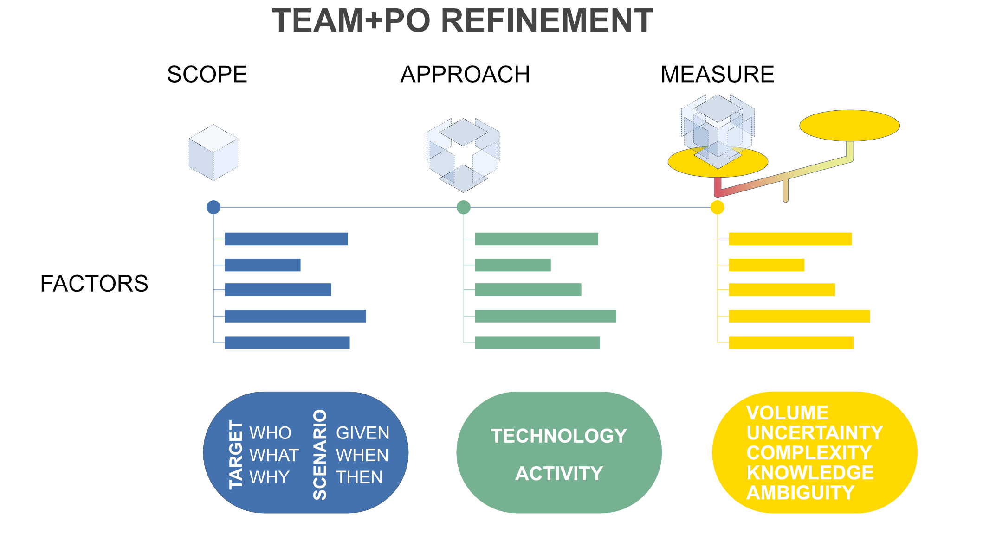
WORKSHOP PRODUCT BACKLOG ITEM MATURITY
WHEN TO DO WHAT
5. Feature Story Mapping
8.a Team Product Refinement
8.b Feature PBI Prioritization
Feature Goal Priority
Does a PBI have an associated Research Spike?
Does a PBI have an associated enabler?
Is one PBI more ambiguous than another within the feature goal?
Feature Story Mapping: New Member Campaign
Find New Members
Campaign Export
Save Member Result Set
By Location
For Excel
By Date
By Age
For Mailer+
By Version
By Plan ID
In JSON
By Expiration
Feature Goal PBI Priority
By Family
For Word
Online
By Employer
Offline
By Condition
Notes:
Feature story mapping is about
first, identifying the goals for a feature
Then identifying the incremental factors that create the value proposition of the goal
BREAKOUT: Build a Feature Story Map
A Feature is fundamentally a container for a set of goals
If a Product Feature grows too large during mapping, how could you break it up? (answer: break up the feature by feature goals)
Must a team sprint on one goal at a time? (answer: No. If they stay focused on the feature, it will reduce context switching, but they could be asked to make progress on the top two feature goals in a single sprint)
If a feature is broken up, however, while you can focus on making progress on more than one feature goal at a time, avoid focusing on making progress in multiple features at the same time.
Feature story mapping identifies the initial list of Goal PBIs. Before the PBI is brought to the team for refinement, it is good to ensure each PBI explains:
The Target: Who, What, and WHY
The initial success scenarios: GIVEN, WHEN, THEN
During Refinement, the team reviews the Feature context, and then the PO presents a PBI and unpacks the initial TARGET and SCENARIO factors.
The team begins asking refining questions to identify:
More details in scenarios and turns them into Gherkin-Style Acceptance Criteria
Next the team considers the scenarios to determine their APPROACH by using something like the UX Canvas:
Ensure you share an understanding of The problem (the WHAT),
the targeted outcome (the WHY),
the primary users (the WHO),
any specific user outcomes and benefits (the scenario-focused Acceptance Criteria),
the solution (their APPROACH),
the business benefit hypothesis (justifying the APPROACH),
important things to do first (cross-team dependencies, needed research spikes, necessary enablers, risks, unresolved ambiguity),
And is the PBI representing a good MVP for this element of the goal (should we break up the PBI into multiple PBIs of good value to the client)?
At this point the team measures their approach using Fibonacci points applied in a relative style (this PBI is shaping up like PBI X and we said that was 3 points. It is a bit larger but I still think it is a 3).
If the points feel too large (larger than any PBI point estimate they have completed in a sprint previously), then the team works with the PO to slice up the story. Some good examples for how to appropriately slice are:
Based on TARGET user (the WHO). If there are multiple users who need slightly different things from the same experience, then separate them.
Based on scenarios. Sometimes you can find affinity groups of related Acceptance Criteria.
Based on data sets (See the above example)
Name some ways it is not recommended to break up a PBI (and talk about why)?

Slide 22
WORKSHOP PRODUCT OWNERSHIP METRICS
ROADMAPPING
DOs
Track Initiatives as Capabilities, as an aggregate of its prioritized features
Track Initiative Features in the roadmap
Track Feature size in T-Shirt sizes
Track Feature in roadmap as a calculation of aggregate child PBI story points divided by the team’s current velocity
Reports on Roadmap progress should be hierarchies by Feature priority with percentage of completion, with progress in terms of number of sprints accomplished with details on Feature changes in: prioritization, Feature scope, team velocity factors (staff changes, poor estimation, staff availability), dependency risks
DON’Ts
Focus on arbitrary deadlines (only include a deadline if there is a strict contractual or regulatory requirement – instead, focus on negotiating priority of features over Initiative deadlines)
Rank Features across Initiatives at the same priority for the same allocated team (you must put them in an order, across Initiatives even if that order must change later)
Change the priority of a Feature in-progress (everything after it can change, be sure what’s next is “ready”)

Slide 23
WORKSHOP PRODUCT OWNERSHIP METRICS
VALUE STREAM METRICS
DOs
Periodically perform a limited time study on the identified value stream (a)value-add, (b) non-value-add, and (c)wait-time time lengths.
Use the results of periodic time studies as a starting point to identify root-causes for long process times, wait times, and transform or eliminate non-value-add activities
If high-level study reveals long running activities within a process, break out the process and value stream map the sub-process to determine waste factors.
DON’Ts
Run time studies in an on-going manner. It will harm long term productivity metrics with an extremely low return on investment relative to the amount of data collection.
Neglect to identify potential change hypothesis without testing them. Test and measure the resulting effectiveness.
Replace Retrospectives with time studies. Whole Agile Teams (PO, SM, Dev Team) do and own the time study and the change hypotheses.

Slide 24
WORKSHOP PRODUCT OWNERSHIP METRICS
FEATURE METRICS
DOs
Embrace the sprinting Feature Cycle Time metric.
From the time the first PBI in the feature moves from TODO to IN-PROGRESS, until the last PBI in the feature moves to ACCEPTED.
Each Feature should be a set of related deliverable client value
If a feature is too large, break up the feature by sorting deliverable value PBIs into multiple features.
Refine whole features before you start to do work on any PBI in the feature
Complete Features in sprinting before you start sprinting on a new Feature
DON’Ts
Work on multiple features at the same time. This will reduce your feature cycle time for both features.
Change the content of a Sprint unless the sprint goal is truly dead. Changing your goal in the middle of a Sprint eliminates the outcome of the current goal, and ensures problems in the new goal, introducing errors and rush.
Multitask the team. Refining in priority order increased the likelihood that exploring the next feature or PBI will relate to the previous one.

Slide 25
WORKSHOP PRODUCT OWNERSHIP METRICS
SPRINT METRICS
DOs
Embrace TEAM VELOCITY as a measure of team productivity over a consistent cadence (how many relative points DONE by a team per 2-week sprint, for example).
Embrace PBI Cycle Time showing how long it took from the moment the PBI moved to IN-PROGRESS to ACCEPTED.
Embrace SPRINT BURN-UP showing Sprint point load over the course of the sprint, team point completion (for whole PBIs) aggregated throughout the sprint, showing DONE achieved daily.
Reward whole Team Continuous Process Improvement resulting from Retrospective tested hypotheses for improvement.
DON’Ts
Reward increased Velocity. Focus on Continuous Improvement and stabilizing velocity to reward consistency and sustainable improvement.
Change the Sprint cadence. Changing the cadence makes it difficult to use the Velocity measure to help load a sprint.
Ask staff to focus on doing their tasks. Instead, ask staff to finish PBIs.
Reward partial points for work that did not deliver value for a client.
Sequester knowledge in sprint by working in a silo. Share and update daily

